Slide 1
Smart Metering
Home Visit App
Process Guide for MOA Field Operatives
16th August 2023 v.2

Slide 2
Context: Home Visit App Explanation and Purpose
Purpose
The Home Visit App (HVA) has been developed to aid the successful installation of smart meters.
Functionality is currently accessed via a URL, however, this will become available via a downloadable App in the near future.
HVA currently provides 2 service activities to improve performance. All engineers are expected to login and use the following:
Location Based Service Solution – The ‘Start Sharing My Location’ button icon prompts you to send a location sharing notification to a customer. This allows them to track your location in real-time, and provides an estimated time of arrival. The benefit of this functionality is to give the customer an accurate timeframe of when you will arrive, with the objective to ‘encouraging customer attendance and reduce ‘No Access’ aborts’.
Comms Checker – This will allow you to carry out diagnostic checks against the smart devices at the customer’s property. By providing a view of the DCC commissioning status, and a communication check against the installed devices, the objectives are to identify any related issues either:
(HVA does not Supersede the current Smart Installation Policy or Error Handling)
Immediately after smart equipment installation or;
On site prior to any smart meter exchange work, if smart metering equipment already exists (i.e. installed on a previous visit)
Performing these diagnostic checks and taking corrective action on site will prevent the need for future revisits.

Slide 3
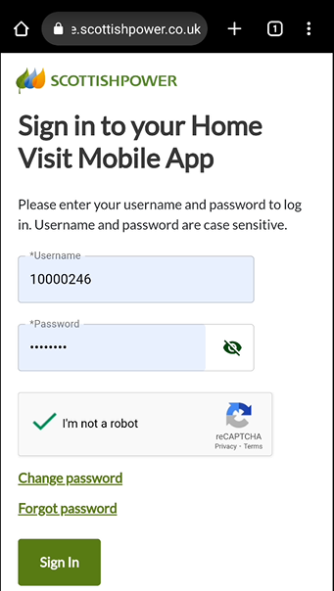
Logging in to HVA
Sign-In
The first step to access the App, is to open your web browser and type in the following URL address:
https://coe.scottishpower.co.uk/homevisit/
You will be provided with a ‘Username’ and a ‘Password’. The Password will need to change after the initial login attempt
Enter your Username and Password
Carry out the CAPTCHA validation check
Click the Sign In button

Slide 4
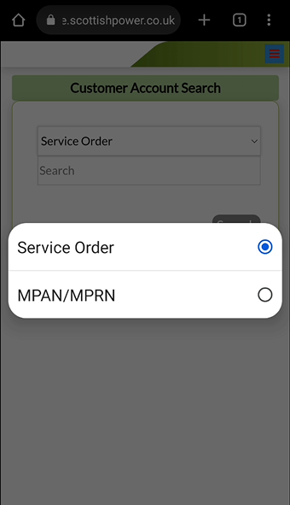
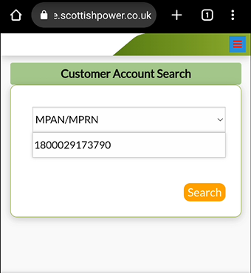
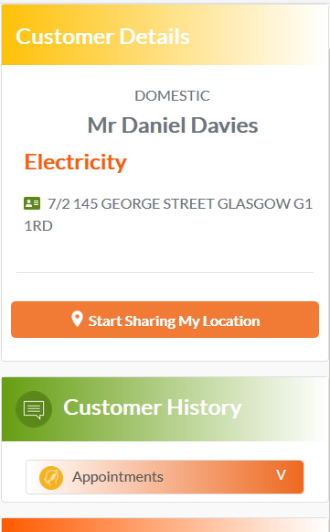
Obtaining Job Information
Search Criteria
Once you have signed in you will be presented with a search option
A drop down field gives you the choice of searching by Service Order or MPxN
Enter the relevant information for your chosen search criteria and click ‘Search’
This will return the customer details in the main screen

Slide 5
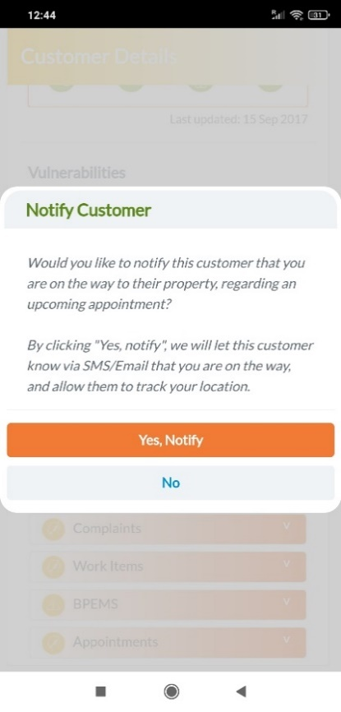
How to use: Location Based Service Solution (Slide 1)
Important Info
Once you have activated this feature you must leave the App running on the screen – Do not lock the device.
If you access a different App, or lock the screen (even if the screen times out), it will prevent the App from refreshing and the customer will not see an update of your progress to their property.
If you do access another App or lock your screen, returning to the HVA will allow your location to refresh.
Where and When to Use
This functionality is designed to be used before you leave for your first/next job, it informs the customer that they are the next appointment, allows them to track your current location and provides them with an estimated arrival time.
Start Sharing Location
This action triggers the sending of an automatic SMS and e-mail to the customer, which contains a URL link to the location tracking page.
Within the main screen click on ‘Start sharing my location’
When the prompt appears, click on ‘Yes, Notify’.

Slide 6
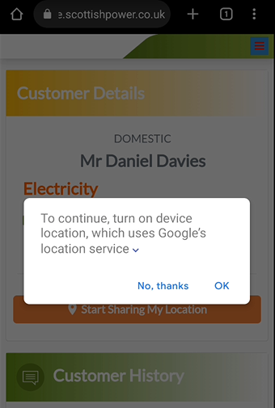
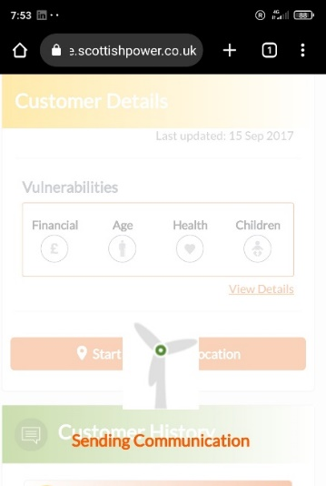
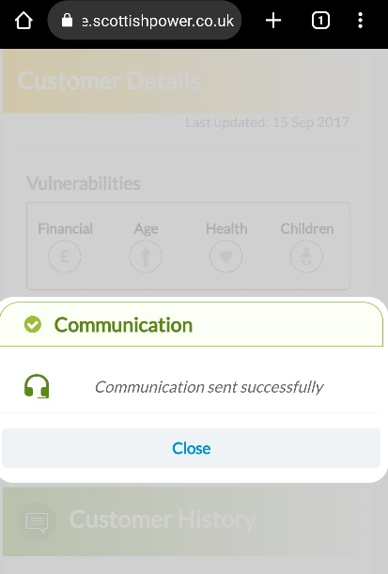
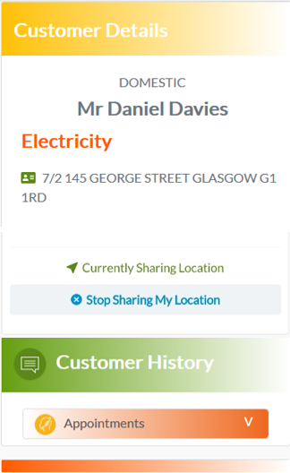
How to use: Location Based Service Solution (Slide 2)
Sending the Communication
Confirmation
Status
You may receive another prompt for you to acknowledge the location provided by Google. If this appears click on ‘OK’ or ‘Allow’.
Once the communication has been sent to the customer you will receive a confirmation
Once you are sharing your location, you will see a status on the main screen of ‘Currently Sharing Location’

Slide 7
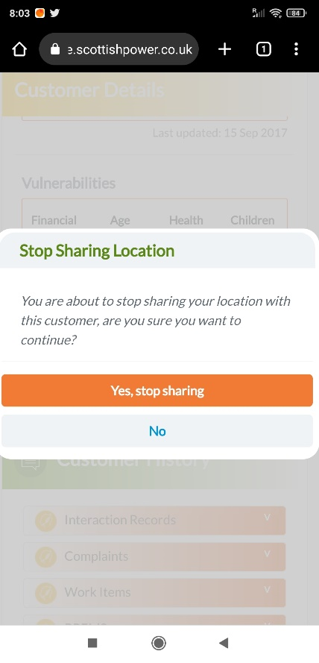
How to use: Location Based Service Solution (Slide 3)
Stop Sharing The Location
Once you have arrived at the property you should stop sharing the location
To complete this click on ‘Stop Sharing My Location’
Then ‘Yes, stop sharing’
This will end the customers ability to view your location

Slide 8
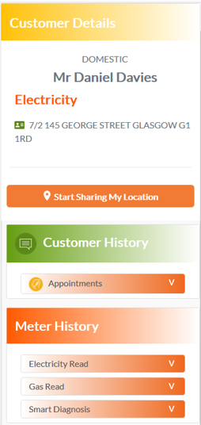
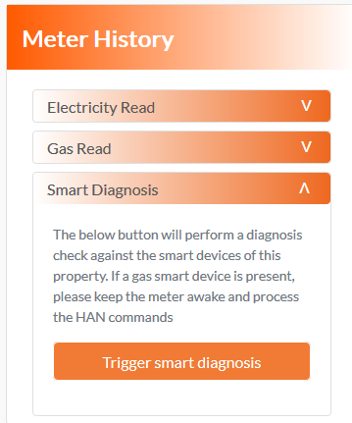
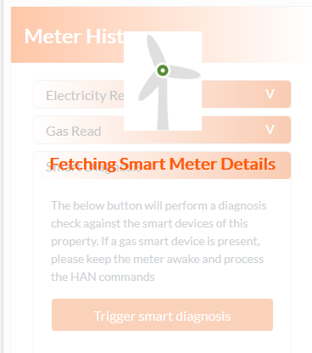
How to use: Comms Checker (Slide 1)
Where and When to Use
This functionality is designed to be used on site, and when you use it will be based on job type. If smart devices are already on site, it should be used before and after carrying out the work to check their status. If carrying out a dumb to smart install then this should be used after completing the job
Triggering Smart Diagnosis
Click on this heading to expand it, this will provide information on how to perform the test
Click on ‘Trigger smart diagnosis’ to start the process
The App will complete an inventory and communications check against the smart devices in the property
Within the ‘Meter History’ section of the main screen there is a heading called ‘Smart Diagnosis’

Slide 9
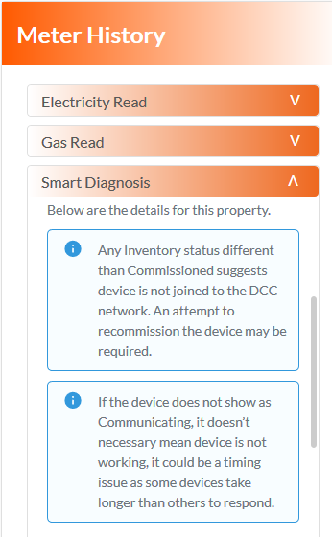
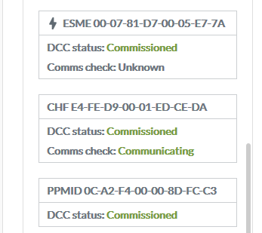
How to use: Comms Checker (Slide 2)
Results
The blue boxes will provide important information to consider. As shown in the screenshot a comms check of ‘Unknown’ doesn’t necessary mean device is not communicating, it can just be due to a timing issue.
You will see a summary of the ;
Smart Device GUID
DCC Commissioning Status
Results of Comms check
* PPMID’s will not show a Comms check, this is specific to CH/ESME/GSME

Slide 10



How to use: Comms Checker (Slide 3)
The following steps shown highlight each of the 3 stages during the Install/Commissioning Process of a Device shown via the DCC status.
After submitting a HHT, the device will remain ‘Whitelisted’ until it has Joined to HAN.
Once the device has Joined to HAN this will move the DCC status into ‘Installed Not Commissioned’.
The final stage will progress the DCC status to ‘Commissioned’.
*Please note a Commissioned Status in HVA during an install does not supersede current Policy around HHT Error Messages and MOA Support should be contacted.

Slide 11
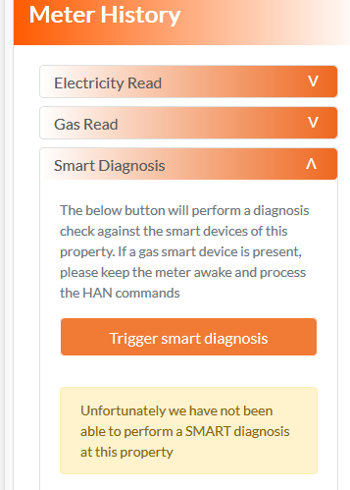
How to use: Comms Checker (Slide 4)
Unable to perform Smart Diagnosis
If this message is received after performing a Smart diagnosis as per the comments in the yellow box, this would indicate no devices are associated the MPxN/Address.
For example Triggering the Smart diagnosis after a HHT send and incurring an E20 DCCASR error message via the HHT, this would be the expected view.

Slide 12
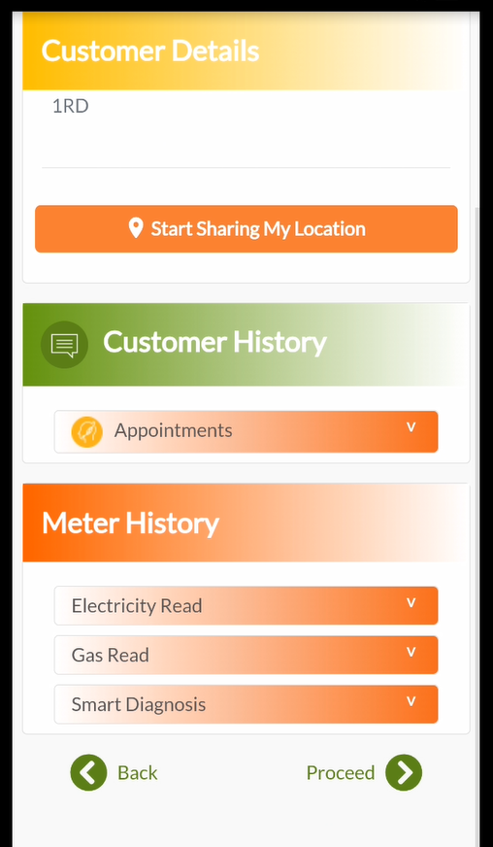
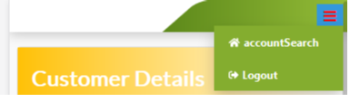
Obtaining details for the next job*
Returning to the Search Function
When you have completed your current job and are ready to inform the next customer that you are on the way you can either:
OR
Click the ‘Back’ button at the bottom of the App until you return to the screen
Click the menu button in the top right hand corner of the App and select ‘Account Search’
*This approach can be taken if the next appointment attended is for an SP customer

Slide 13
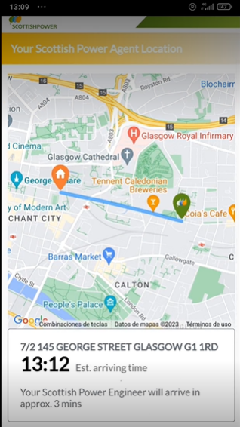
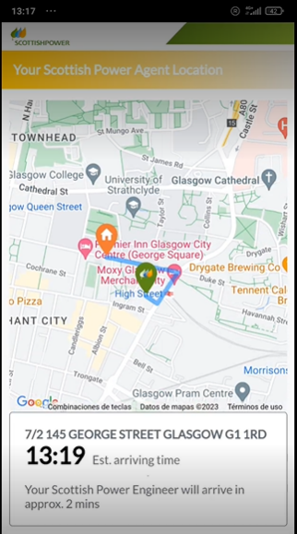
Appendix: Customer View of Agent Location
Examples of the view a customer will have of your location

